Slide 1
Lead Score Case study
Group Members
Rahul patil
Nithin Vijayabaskaran
Pratik Joshi

Slide 2
Problem Statement
X Education sells online courses to industry professionals.
X Education gets a lot of leads, its lead conversion rate is very poor. For example, if, say, they acquire 100 leads in a day, only about 30 of them are converted.
To make this process more efficient, the company wishes to identify the most potential leads, also known as ‘Hot Leads’.
If they successfully identify this set of leads, the lead conversion rate should go up as the sales team will now be focusing more on communicating with the potential leads rather than making calls to everyone.
Business Objective:
X education wants to know most promising leads.
For that they want to build a Model which identifies the hot leads.
Deployment of the model for the future use.

Slide 3
Solution Methodology
Data cleaning and data manipulation.
Handle duplicate data and check the whole set.
NA values and missing values need to be handled.
If a column contains large number of missing values and not useful for analysis those columns to be dropped.
Outliers in the data need to be verified and handled.
EDA
Univariate data analysis
Bivariate data analysis
Dummy Variables and encoding of the data.
Classification technique: logistic regression used for the model making and prediction.
Model building and validation.
Conclusions and recommendations.

Slide 4
Data Manipulation
Total Number of Rows =32, Total Number of Columns =9240.
Dropping the columns having more than 20% as missing value.

Slide 5
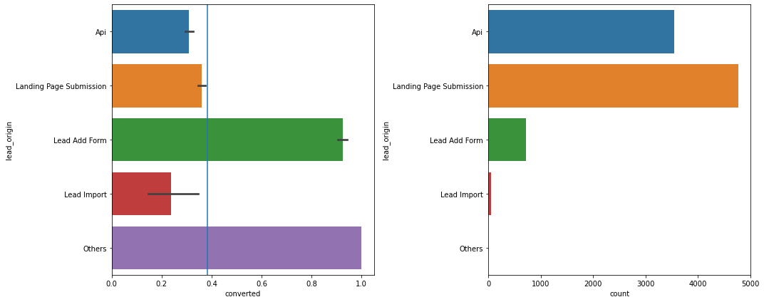
EDA

Slide 6
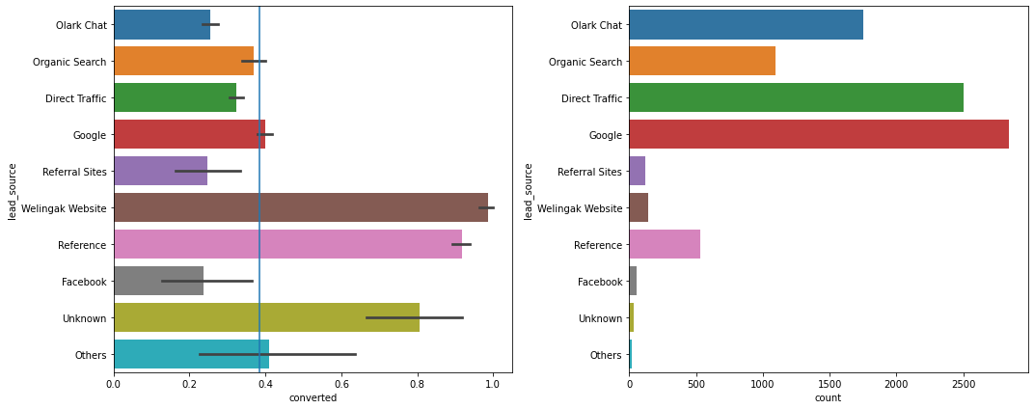
Categorical variable Relation

Slide 7
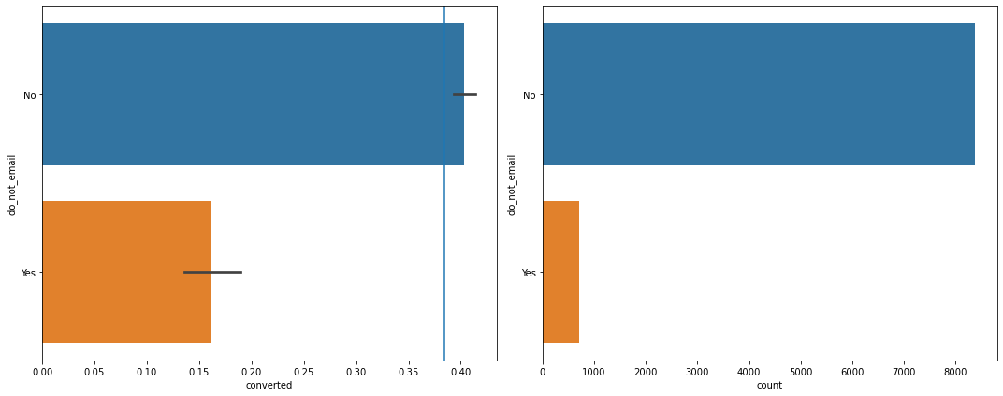

Slide 8
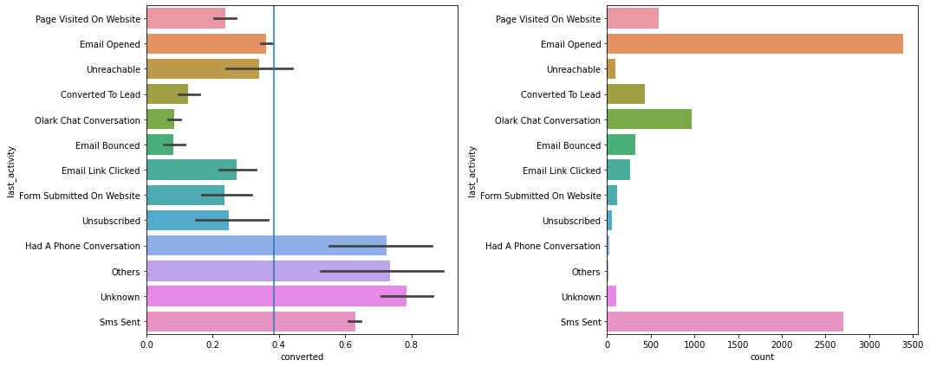
If the last activity is an sms sent, then there is high chance of conversion

Slide 9
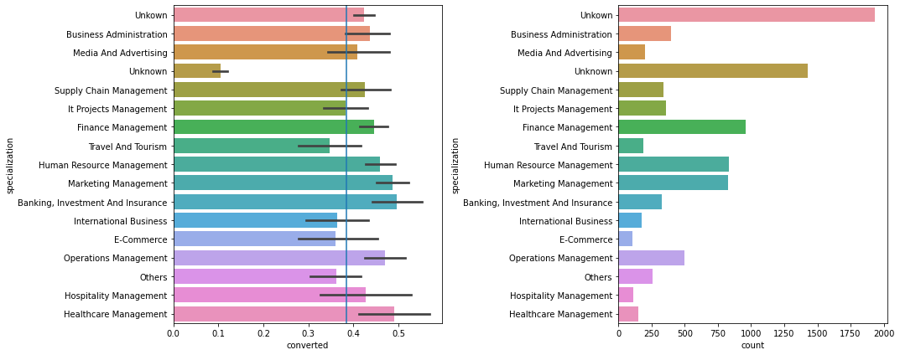
If there is no specialization i.e. unknown the conversion rate drops suddenly
All Management studies have a good conversion rate

Slide 10
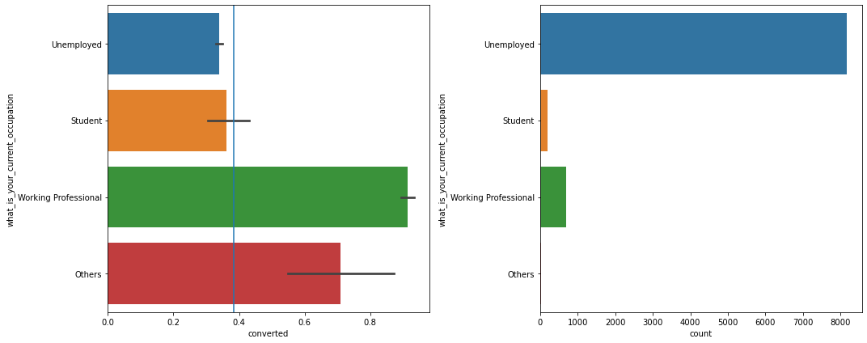
Work Professionals are a good bracket to target

Slide 11
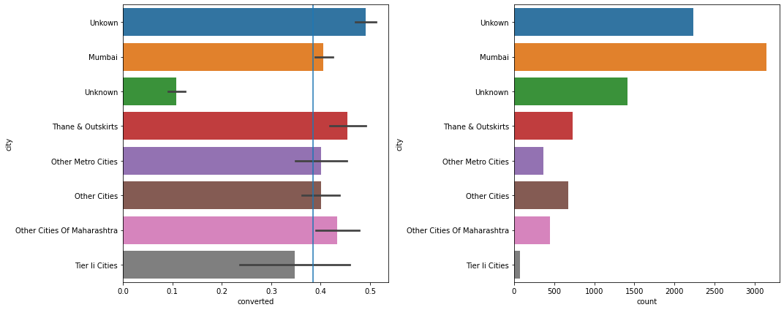
When city is not mentioned the conversion rate drops

Slide 12
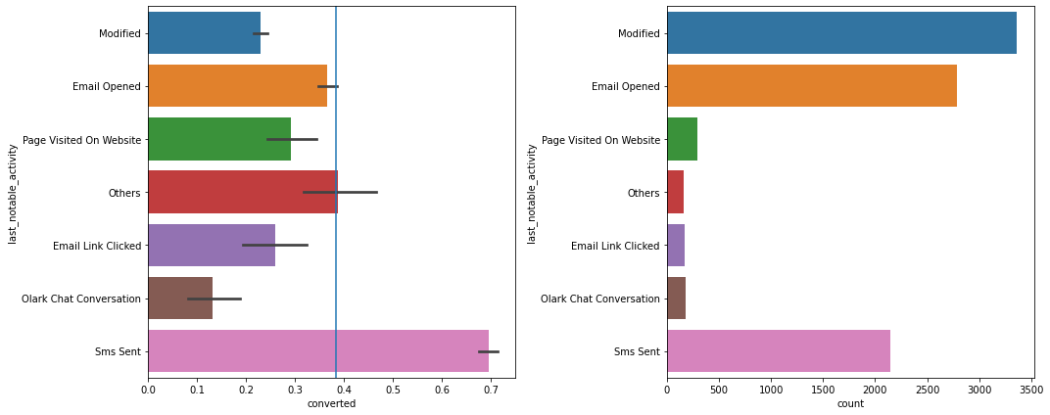
Sms Sent is a good indicator

Slide 13
Model Building
Splitting the Data into Training and Testing Sets
The first basic step for regression is performing a train-test split, we have chosen 80:20 ratio.
Use RFE for Feature Selection
Running RFE with 20 variables as output
Building Model by removing the variable whose p- value is greater than 0.05 and VIF value is greater than 5
Predictions on test data set
Overall accuracy 82%

Slide 14
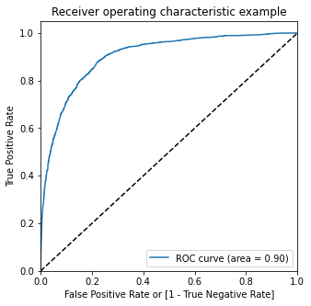
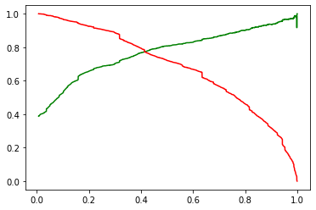
ROC Curve
Finding Optimal Cut off Point
Optimal cut off probability is that probability where we get balanced sensitivity and specificity.
From the second graph it is visible that the optimal cut off is at 0.40.

Slide 15
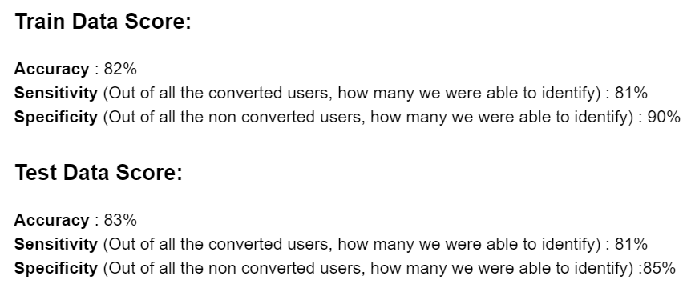
Conclusion
It was found that the variables that mattered the most in the potential buyers are (In descending order) :
The total time spend on the Website.
Total number of visits.
When the lead source was: a. Google b. Direct traffic c. Organic search d. Welingak website
Keeping these in mind the X Education can flourish as they have a very high chance to get almost all the potential buyers to change their mind and buy their courses.

